Slide 1

Control of Laminate Biped
Taha Shafa

Slide 2
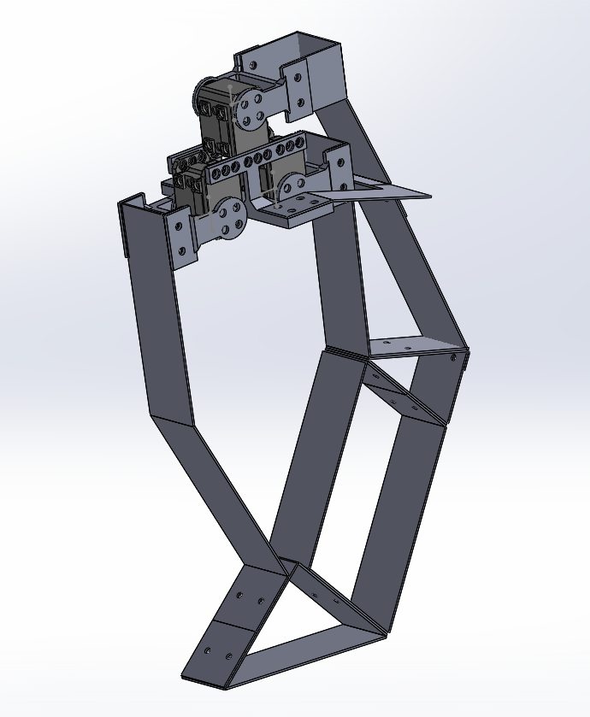
Previous Work
Developed prototype bipedal platform
Worked with Pynamics and Mujoco to model leg
Model needed to develop controller
Pynamics can be used to determine system model
Mujoco can be used to simulate leg movement with an implemented controller

Slide 3
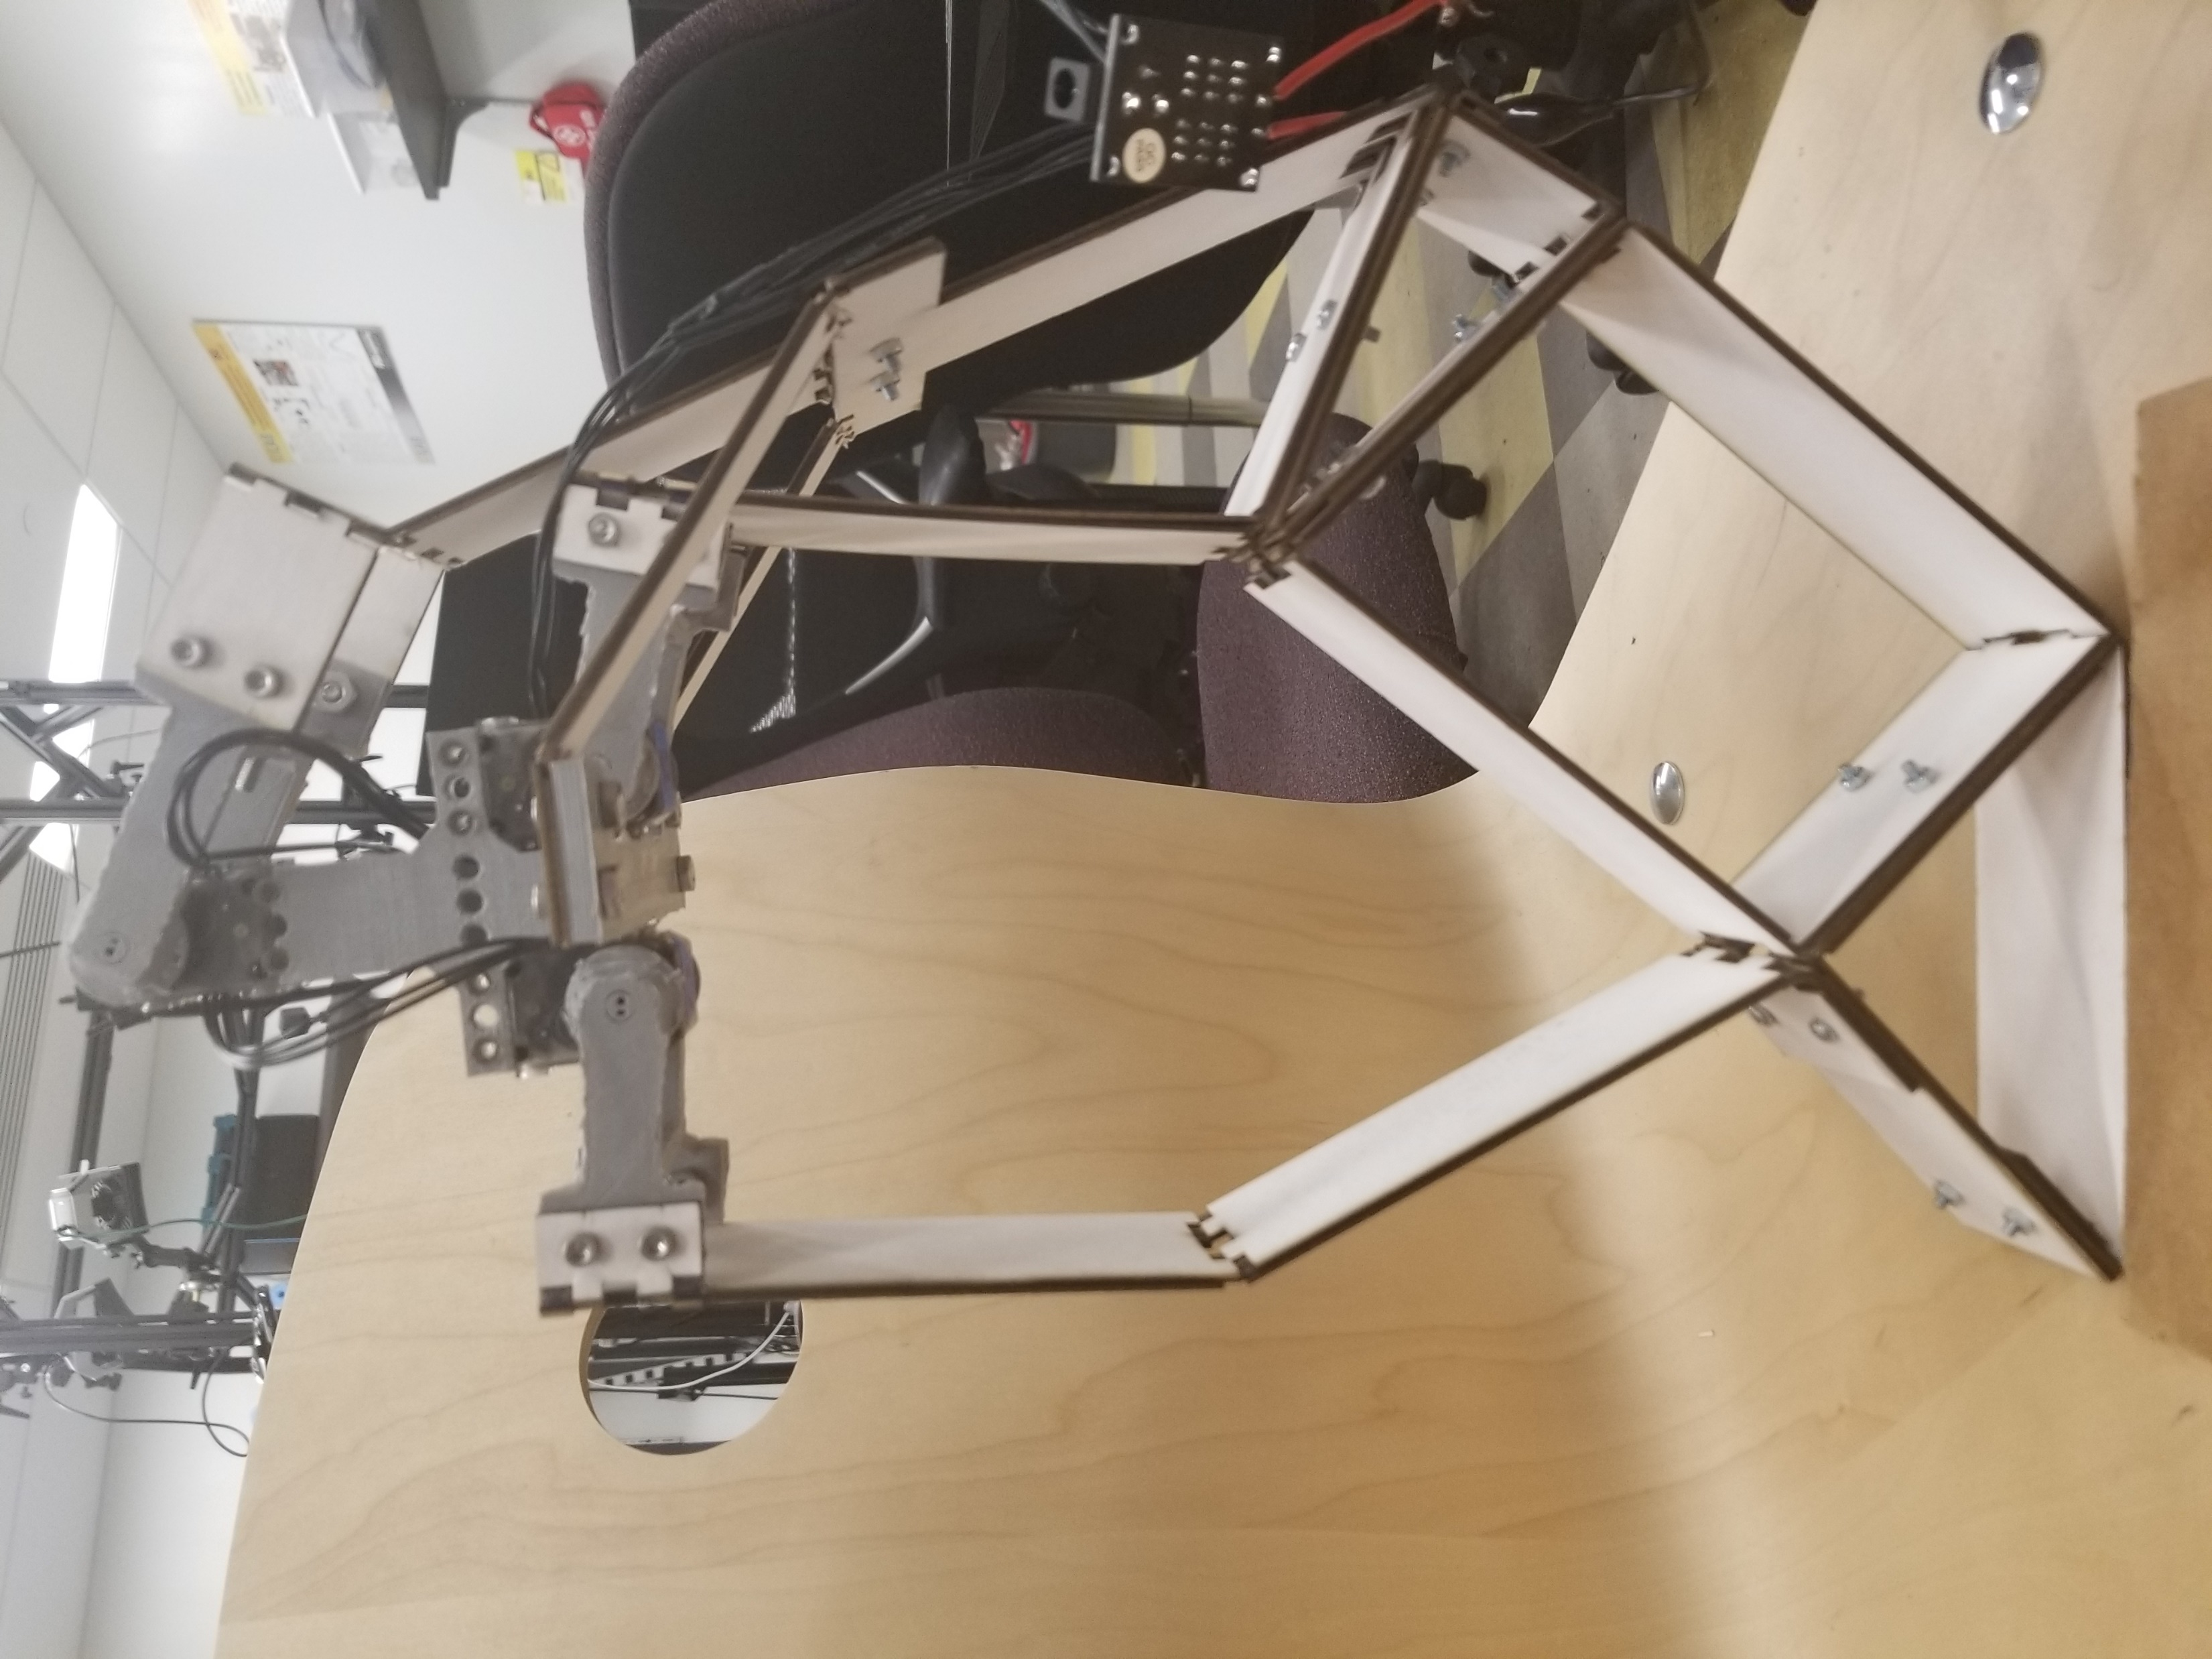
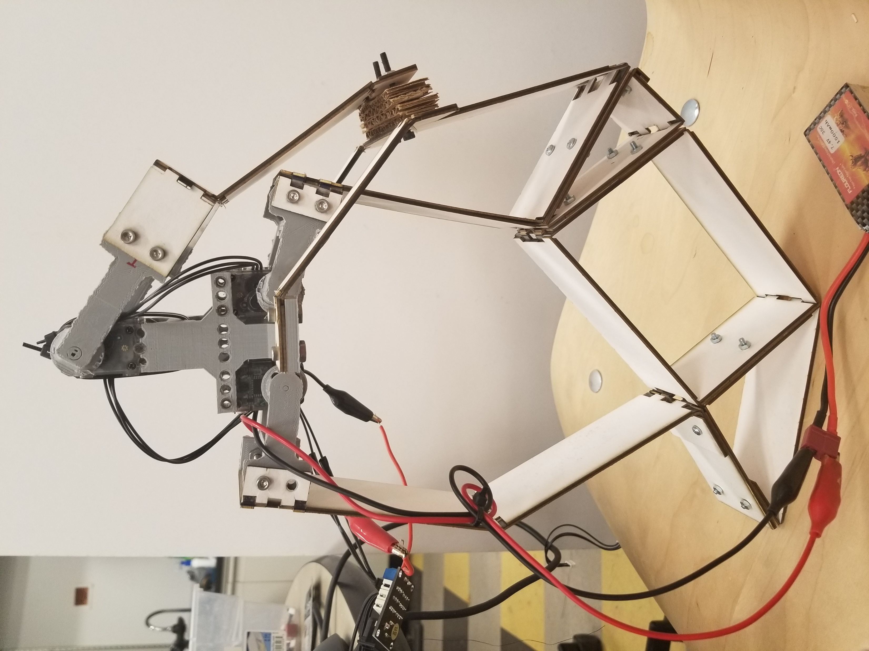
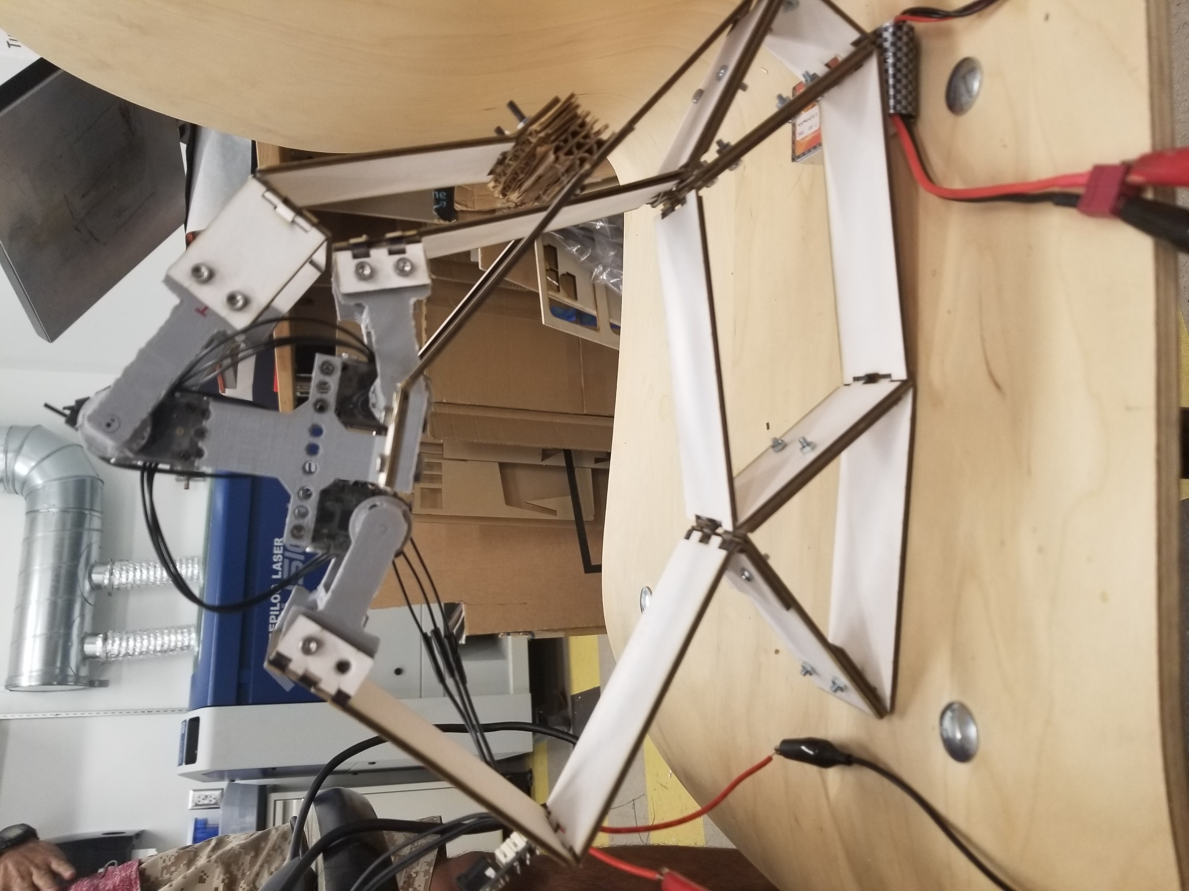
Resent Redesign Attempt

Slide 4
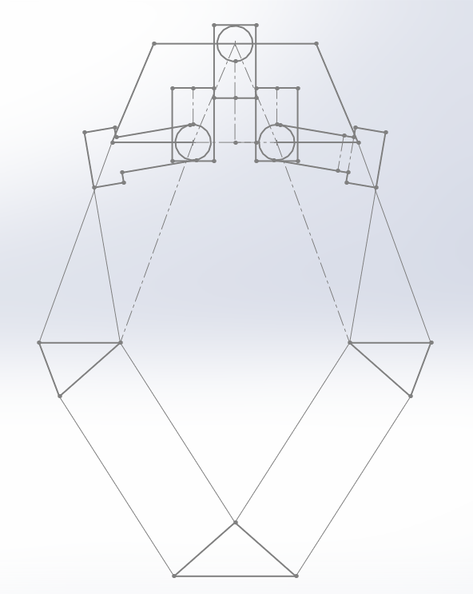
Recent Design Modification
Symmetric
Link lengths decreased by 15 mm
Suspended base improved
Height of top motor decreased
Adapted to support new symmetric design
Link width decreased
Reduce mass
Decrease error between links and motor horn
Custom motor horns redesigned

Slide 5
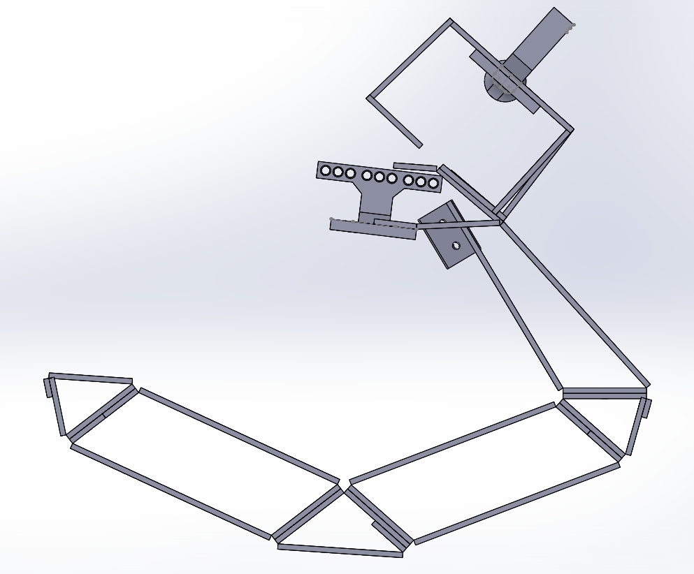
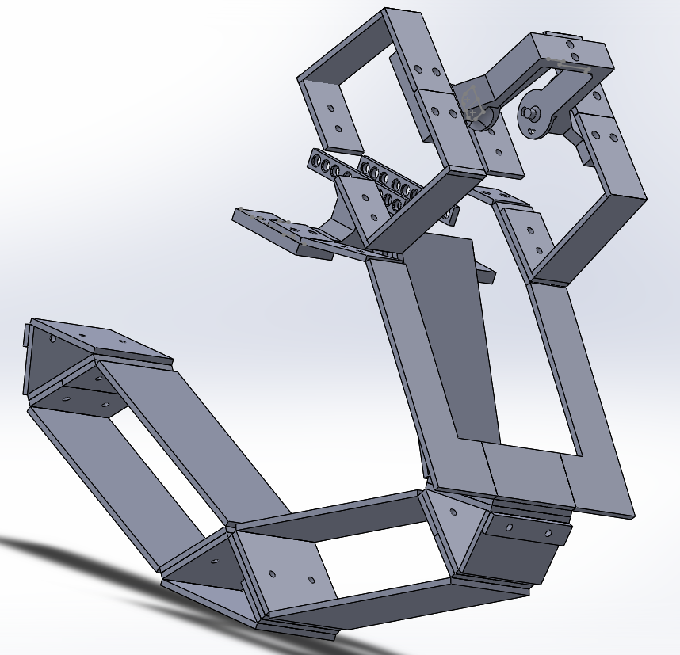
3D rendering

Slide 6
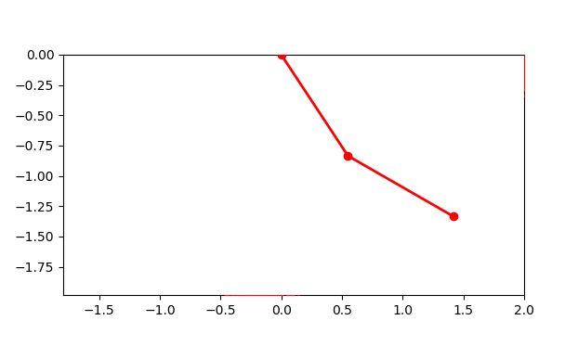
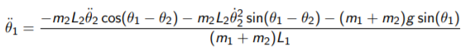
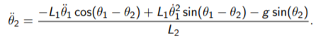
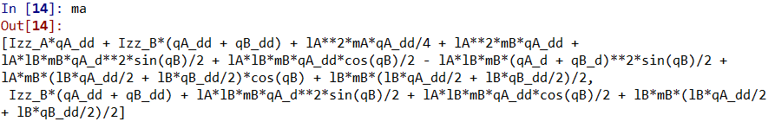
Pynamics
Lagrange
Pynamics

Slide 7
Current/Future Work
Manufacture new leg design with rivets (not screws)
Run tests to determine control space and feasibility of Dynamixel XL-320
Continue work with Pynamics for modeling
Determine way to arrive at linearized system starting with double inverted pendulum
Implement control system design on MuJoCo
Begin by implementing controller for double inverted pendulum

